Slide 1

Alternatives to Academia
Dave Bacon

Slide 2
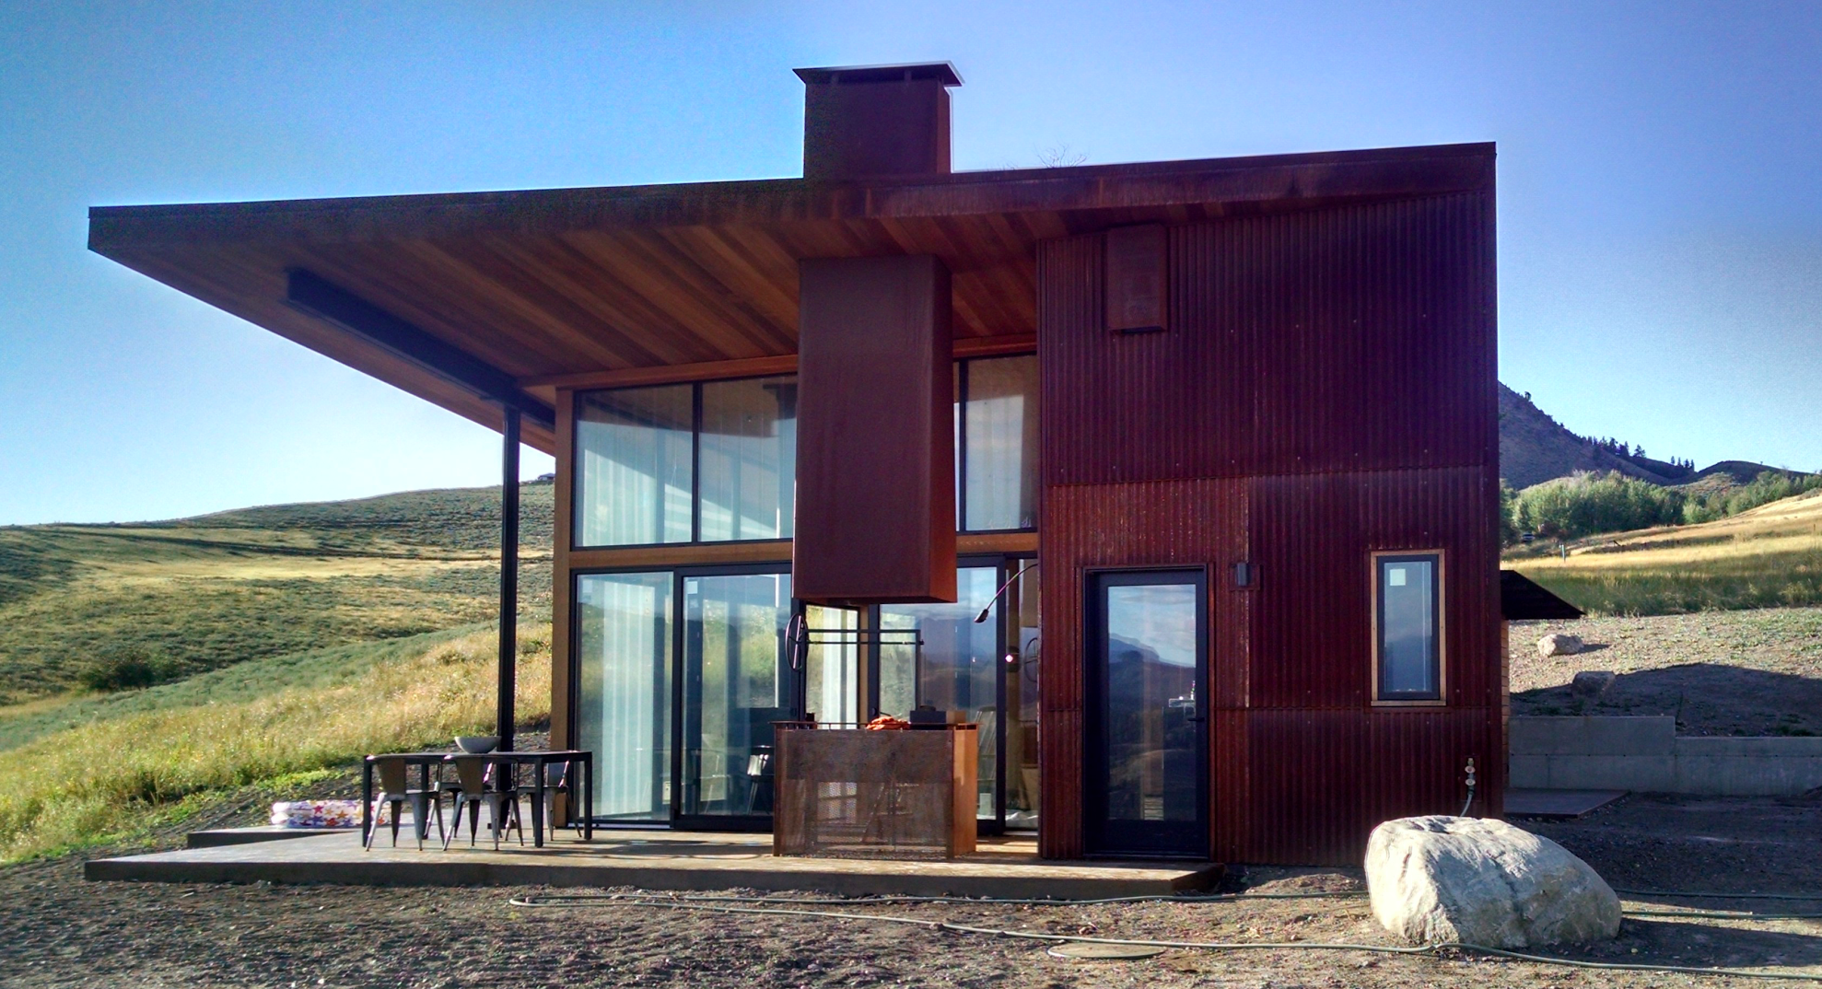
Alternatives to Academia
Dave Bacon

Slide 3
Repeat After Me
You are not a failure if you decide to leave academia.

Slide 4
My Story

Slide 5
Investigations*
industry labs
national labs
alternative research institutes
professorate
research jobs
analyst
data scientist
“research-like” jobs
tech companies
startups
companies turning research into product
companies that value skills learned as a researcher
way more than you think
* Note, most of the world sees the world through the inverse of this diagram.

Slide 6
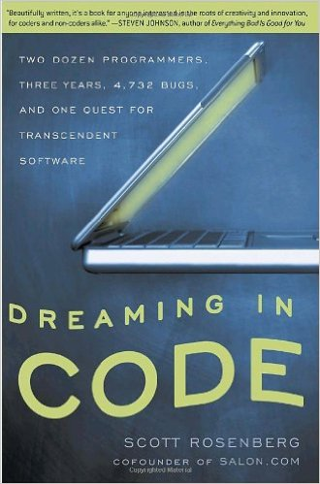
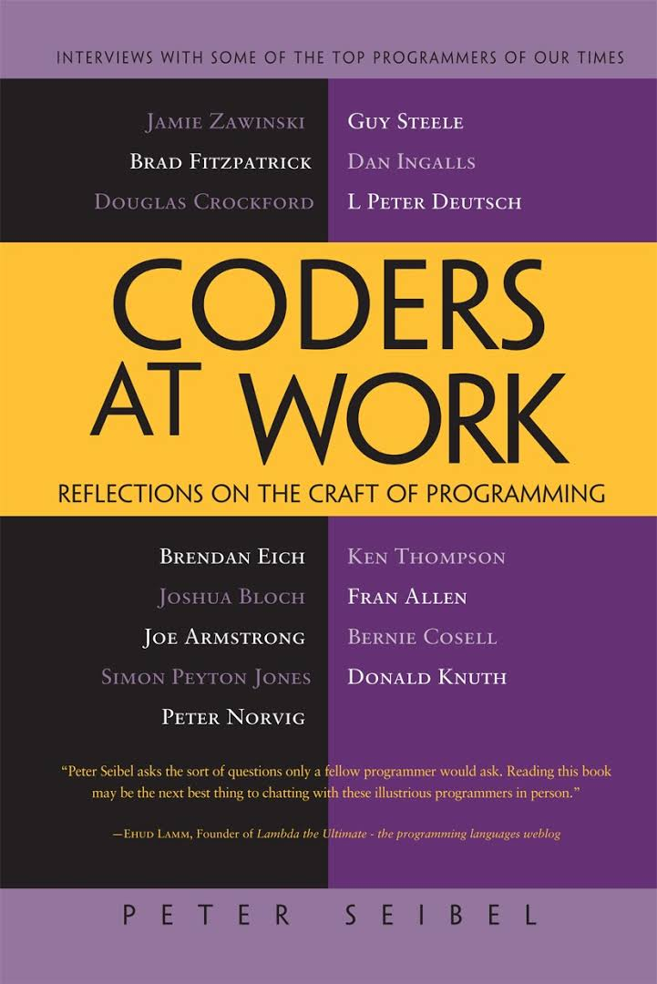
Immersion

Slide 7
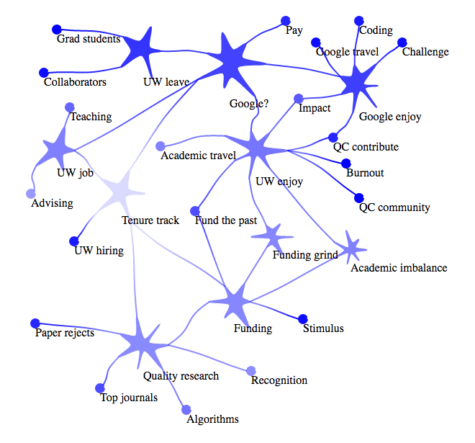
Decisions
http://dabacon.org/pontiff/?p=10176

Slide 8
Transitions
Twenty years he persisted in that controlled hallucination, but one morning he was overcome by the surfeit and the horror of being so many kings who die by the sword and so many unhappy lovers who converge, diverge, and melodiously agonize. That same day he disposed of his theater. Before a week was out he had returned to the village of his birth, where he recovered the trees and the river of his childhood; and he did not bind them to those others his muse had celebrated, those made illustrious by mythological allusions and Latin phrases. He had to be someone; he became a retired impresario who has made his fortune and who interests himself in loans, lawsuits, and petty usury. In this character he dictated the arid final will and testament that we know, deliberately excluding from it every trace of emotion and of literature. Friends from London used to visit his retreat, and for them he would take on again the role of poet.
Everything and Nothing - Jorge Luis Borges

Slide 9


Transitioned
Fulfilling
Impactful
Fun
Boss
Direction
Actual Job

Slide 10

Thank You

